Slide 1
Project Group AICoN: Artificial Intelligence for Computer Networks
Seminar paper: Adaptive Prediction Models for Data Center Resources Utilization Estimation
Lameya Afroze (6869313)

Slide 2
Outline
Introduction
Proposed System Methodology
Proposed Model Evaluation
Experimental Results
References

Slide 3
Introduction
Accurate estimation of resource utilization is important for minimizing the operational cost and maximizing the performance of data center.
In this paper the authors has presented an adaptive multi-methods approach which automatically selects the most promising machine learning method to estimate resources utilization of data center.

Slide 4
Proposed System Methodology
Workload Prediction
Resource utilization logs are divided into fixed size sliding windows with specific time interval.
Four machine learning models for predicting results. The models are Linear Regression, Support vector regression, Gradient boosting and Gaussian Process Regression (in paper mentioned as Kriging).
Adaptive Model Selector (AMS)
Predicts the best regression model for each time stamp.
Use 5 classification model to choose the regression model. These models are K-Nearest Neighbors, Naïve Bayes, Multilayer Perception, Random Decision Forest (RDF) and Gradient Boosting.
Generate workload using the selected regression model.

Slide 5
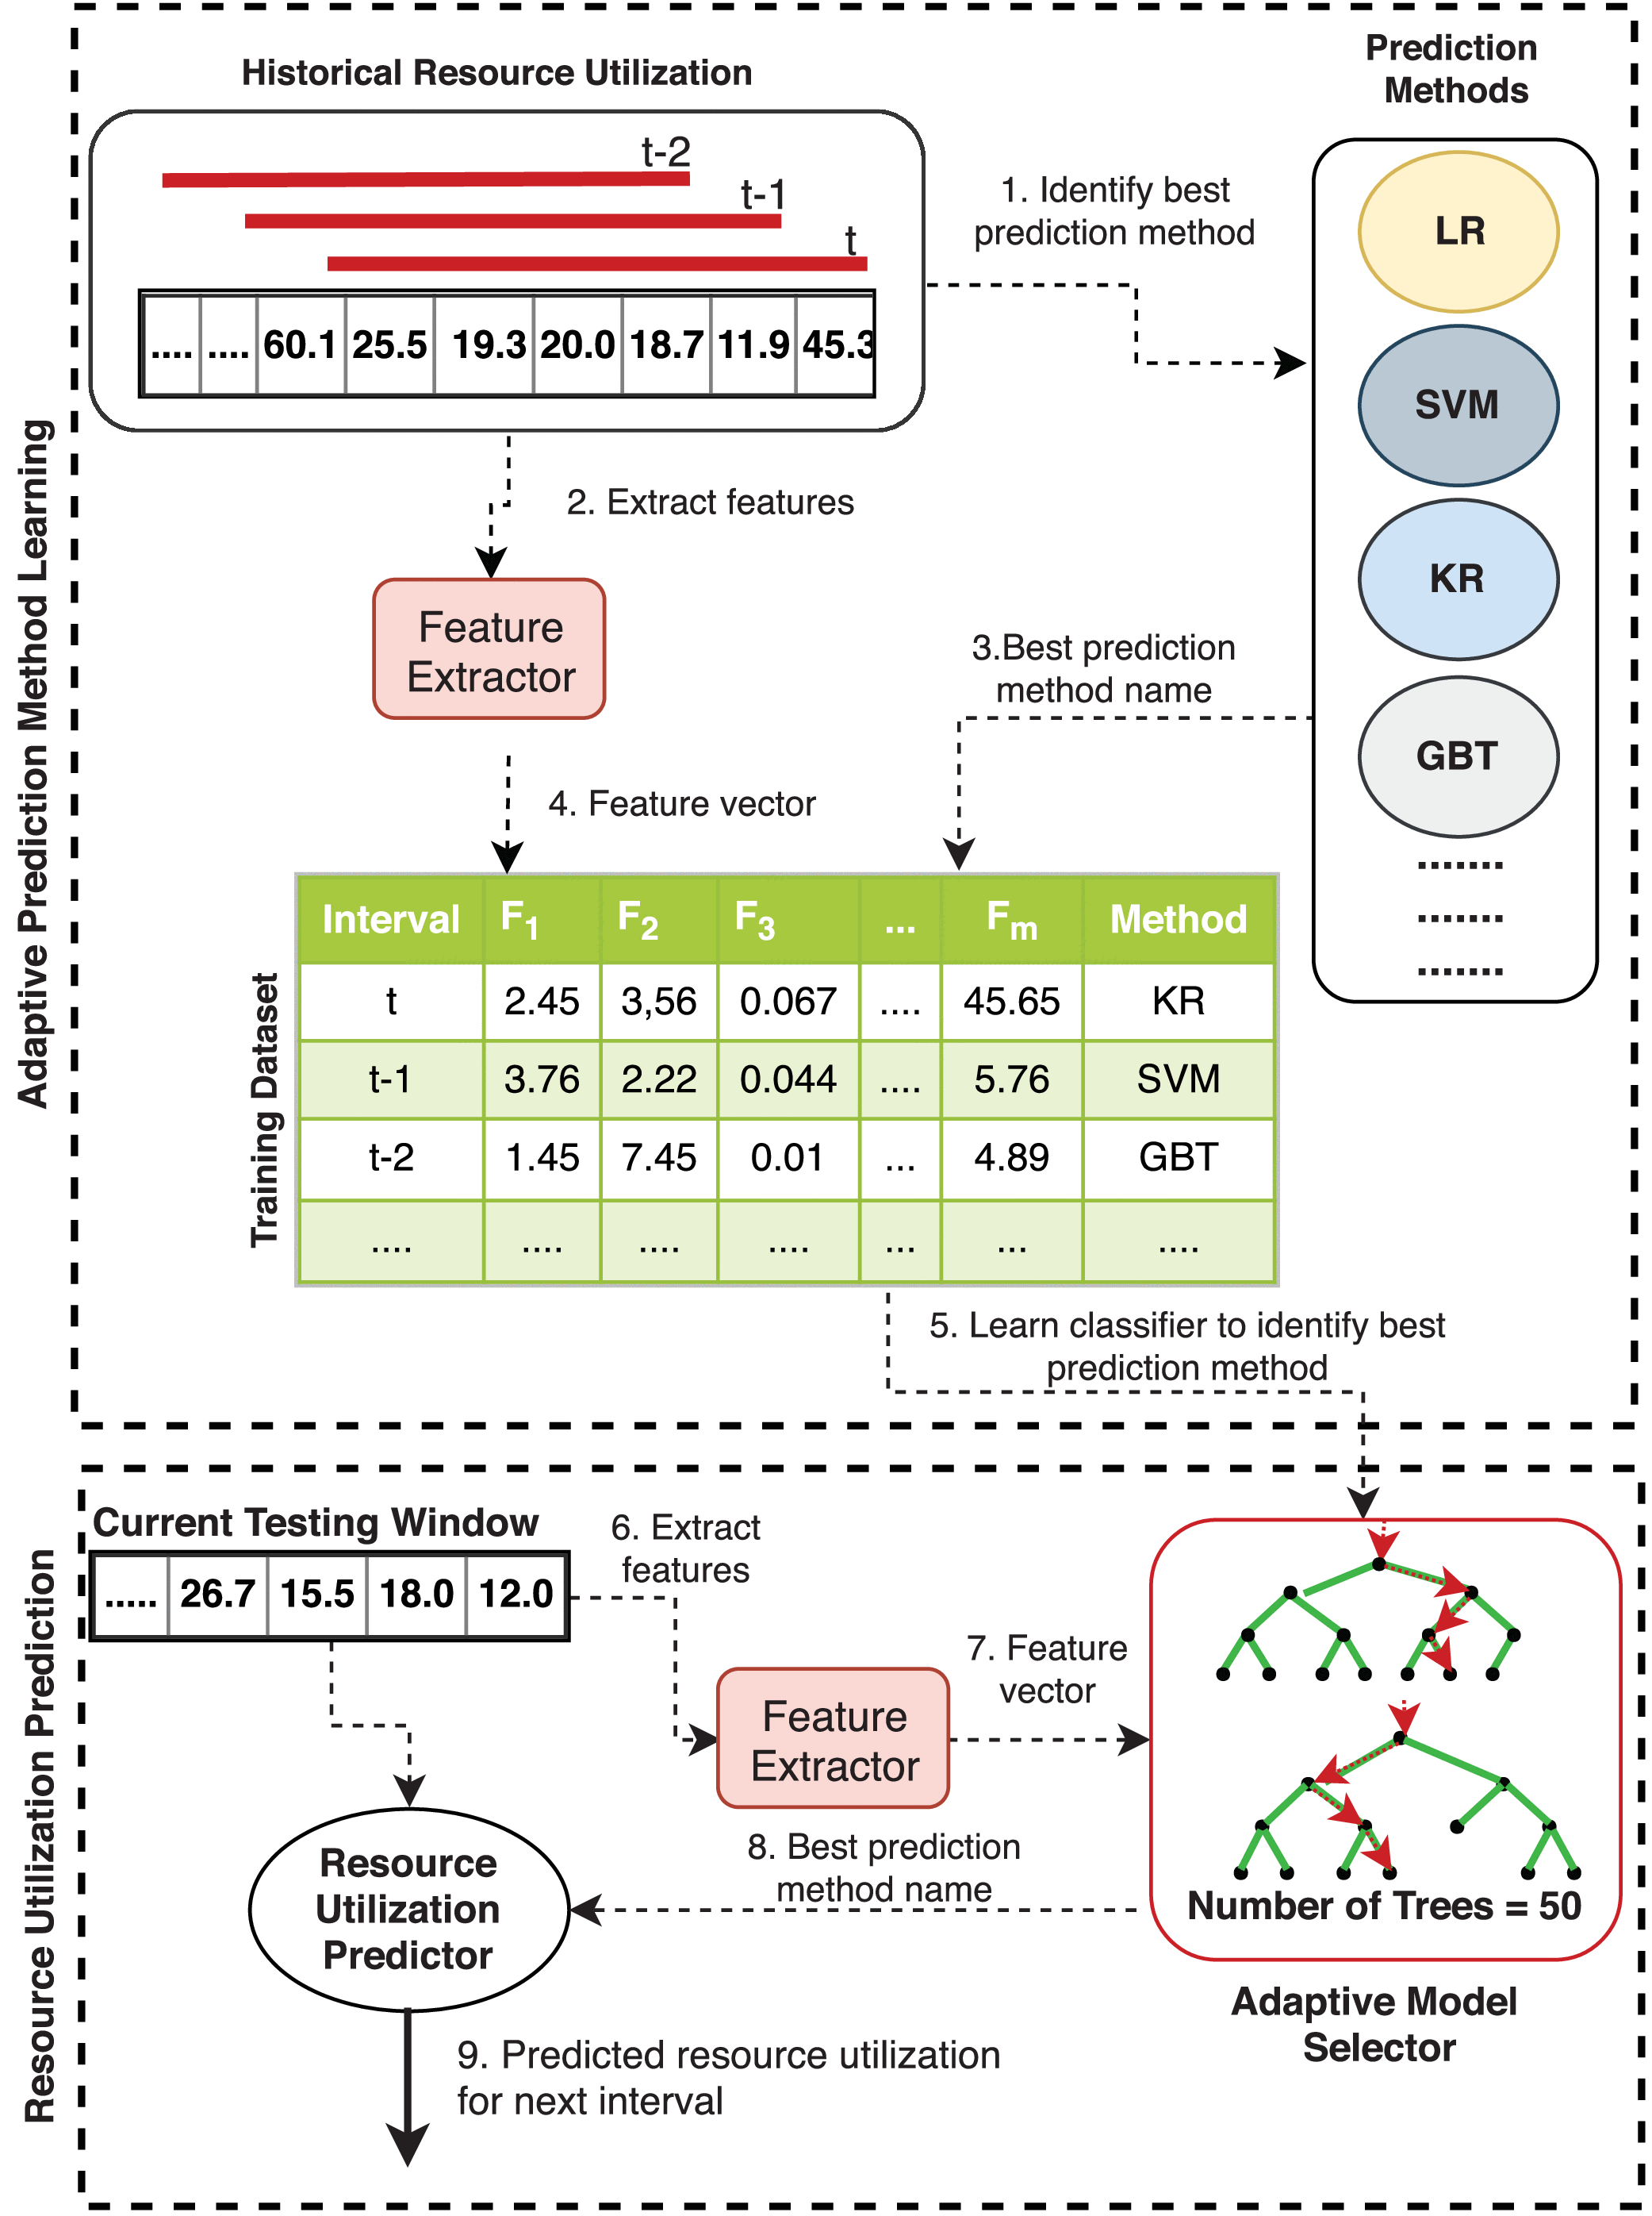
Proposed Model Evaluation
Datasets
Alibaba datasets [1]
Bit brain datasets [2]
Google cluster traces [3]
Feature Extraction & AMS Evaluation
Use several features (prediction time, size, accuracy, precision, recall, F-measure, positive rate etc.) to extract datasets.
Create training dataset with best prediction method for each time interval.
Predict best model using AMS.
Resource Estimation
Perform random split 80% / 20% of training / validation sets to estimate resource.
Calculate Root-Mean Square Error (RMSE) & Mean Absolute Error (MAE) to measure the error of each regression model.

Slide 6
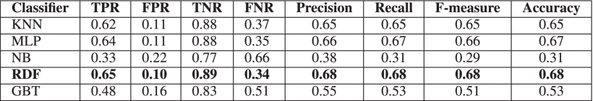
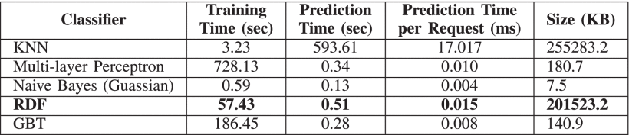
Experimental Results (1)
AMS Evaluation
Table 1: AMS evaluation results using different classifiers for Alibaba dataset[4].

Slide 7
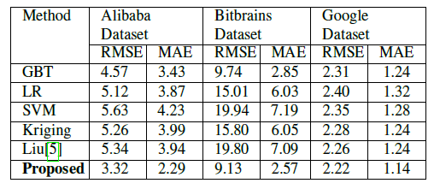
Experimental Results (2)
Dataset Resource Estimation & Window Size Sensitivity

Slide 8
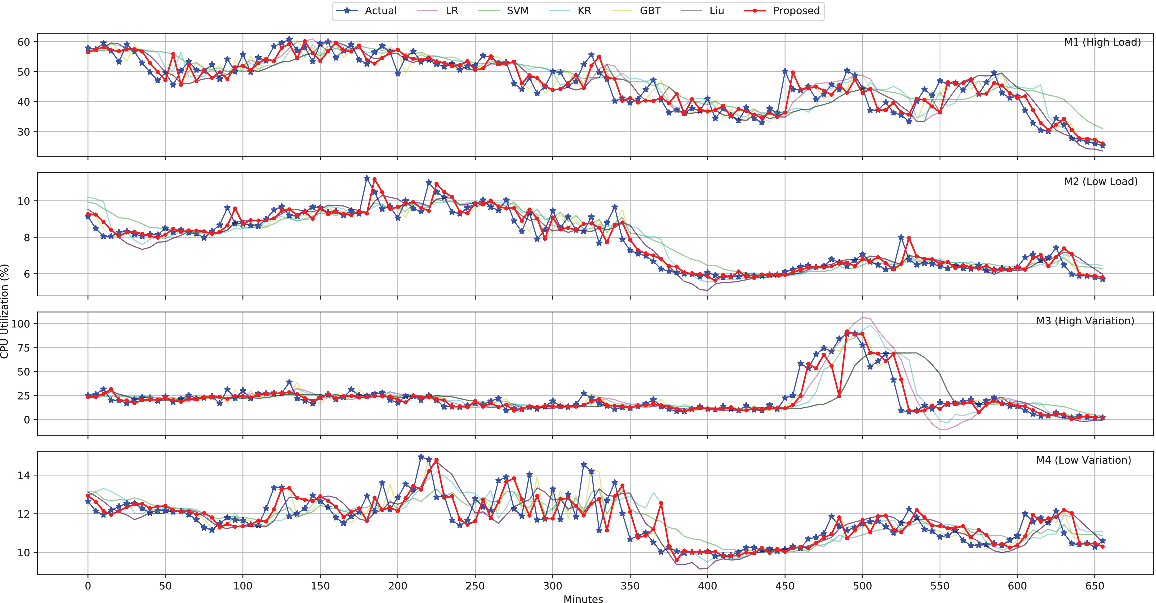
Experimental results (3)
Dataset Resource Estimation & Window Size Sensitivity

Slide 9
References
[1] Alibaba Cluster Log. Available url =https://github.com/alibaba/clusterdata. Accessed:16-May-2020.
[2] Bitbrains Cluster Log. Available url =http://gwa.ewi.tudelft.nl/datasets/gwa-t-12-
bitbrains. Accessed: 16-May-2020.
[3] Google Cluster Log. Available url =https://github.com/google/cluster-data. Accessed:16-May-2020.
[4] S. Baig, W. Iqbal, J. L. Berral, A. Erradi, andD. Carrera. “Adaptive Prediction Models for Data CenterResources Utilization Estimation”.In:IEEE Transactions on Network and Service Management16.4 (2019), pp. 1681–1693.
[5] C. Liu, C. Liu, Y. Shang, S. Chen, B. Cheng, and J. Chen. “An adaptive prediction approach based on workload pattern discrimination in the cloud”. In: Journal of Network and Computer Applications 80 (2017), pp. 35–44.

